Slide 1
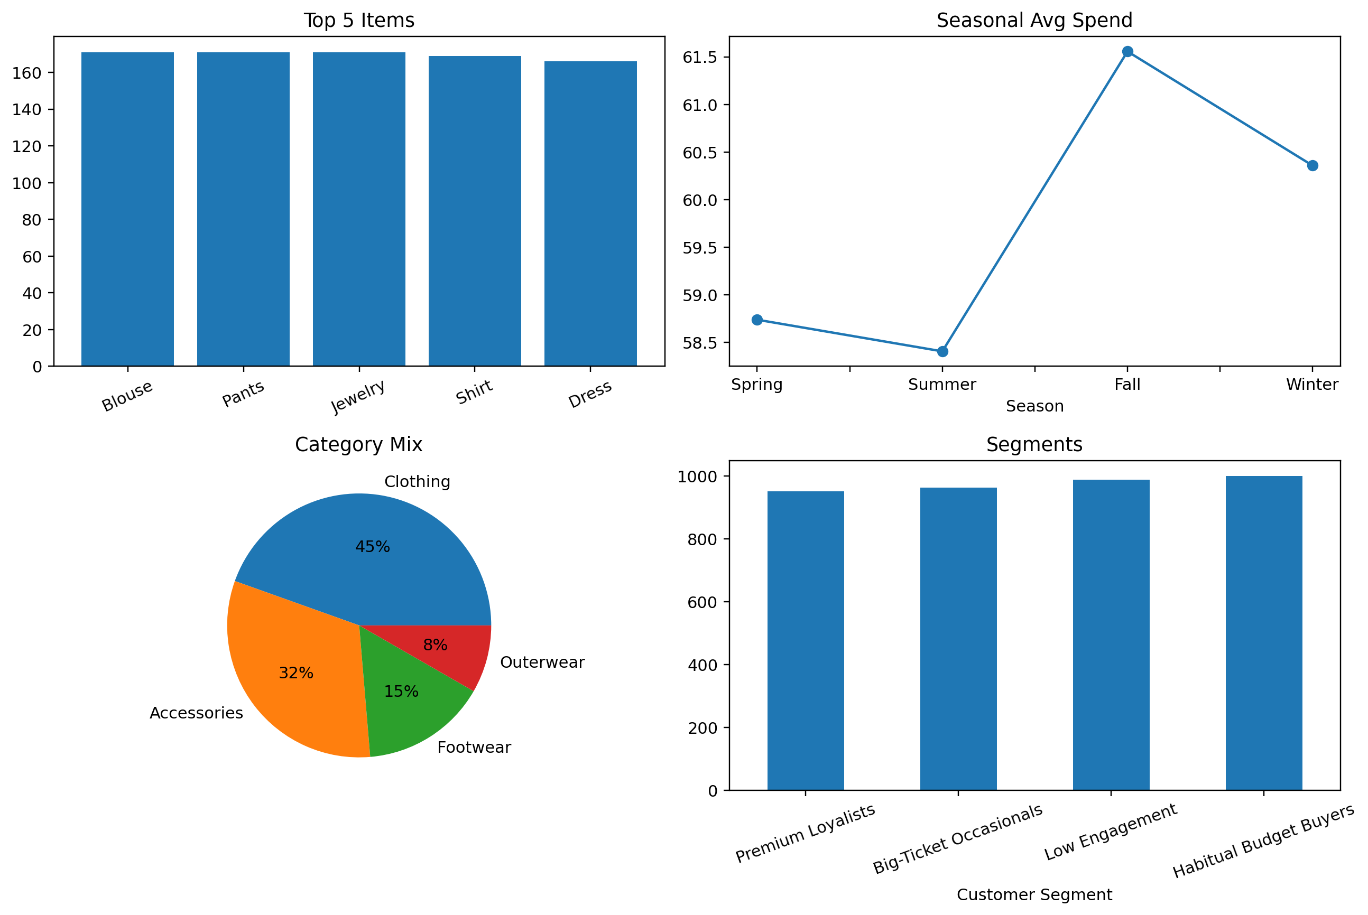
Customer Purchase Behavior Analysis
Approach used: Exploratory Data Analysis and Visuals.
Final Presentation
Student Name: Hritik Agarwal
Course: MCA
Enrollment No: O24MCA110547
Guide/Mentor: Anurag Goel
Dataset: Shopping Trends Dataset (~3,900 records)
Tools Used : Python, Pandas, NumPy, Matplotlib
EDA report + GitHub-ready project files
Notes:
[Sources] - Dataset description: https://data.mendeley.com/datasets/xv99b2mtfk/1 - Public repo summary of the same 3,900-record shopping trends structure: https://github.com/nileshely/Customer-Shopping-Trends - Charts in this deck were generated locally from shopping_trends.csv using src/analyze_customer_behavior.py

Slide 2
Project Objective and Data Overview
This project sought to comprehend the impact of various parameters such as customer demographics, type of products purchased, seasons, and means of payment on spending by customers. The main objective is the analysis of the data provided in order to derive valuable insights..
Around 3,900 customer records
18 Features
Main questions
No missing values or duplicate rows
• Which product categories are most popular?
• Does spending change across seasons?
• Which payment methods are commonly used?
• Can we divide customers into meaningful groups?
Even though the data is clean, I did some basic validation and preprocessing just to be sure. Given that the data isn’t chronological and rather snapshot-like, I utilized estimates such as purchase period and CLV.
Notes:
[Sources] - Dataset description: https://data.mendeley.com/datasets/xv99b2mtfk/1 - Public repo summary of the same 3,900-record shopping trends structure: https://github.com/nileshely/Customer-Shopping-Trends - Charts in this deck were generated locally from shopping_trends.csv using src/analyze_customer_behavior.py - Key facts used on this slide: 3,900 records and customer behavior fields from the dataset source pages.

Slide 3
Methods and Feature Engineering
Data understanding
Data cleaning and checking
Exploratory data analysis
Feature creation
Visualization
Insights and conclusions
Derived fields used in the project
Note: -
Because there are no timestamps in the dataset, these numbers are approximations. I have made this clear because of the risk of making too much of the data.
• Estimated purchases per year
• Purchase interval (in days)
• Annual spending estimate
• Approximate 3-year CLV
• Customer segments based on rules
Notes:
[Sources] - Dataset description: https://data.mendeley.com/datasets/xv99b2mtfk/1 - Public repo summary of the same 3,900-record shopping trends structure: https://github.com/nileshely/Customer-Shopping-Trends - Charts in this deck were generated locally from shopping_trends.csv using src/analyze_customer_behavior.py - The workflow diagram is original slide content. Non-trivial claims about dataset limitations are grounded in the available fields shown in the public dataset pages.

Slide 4
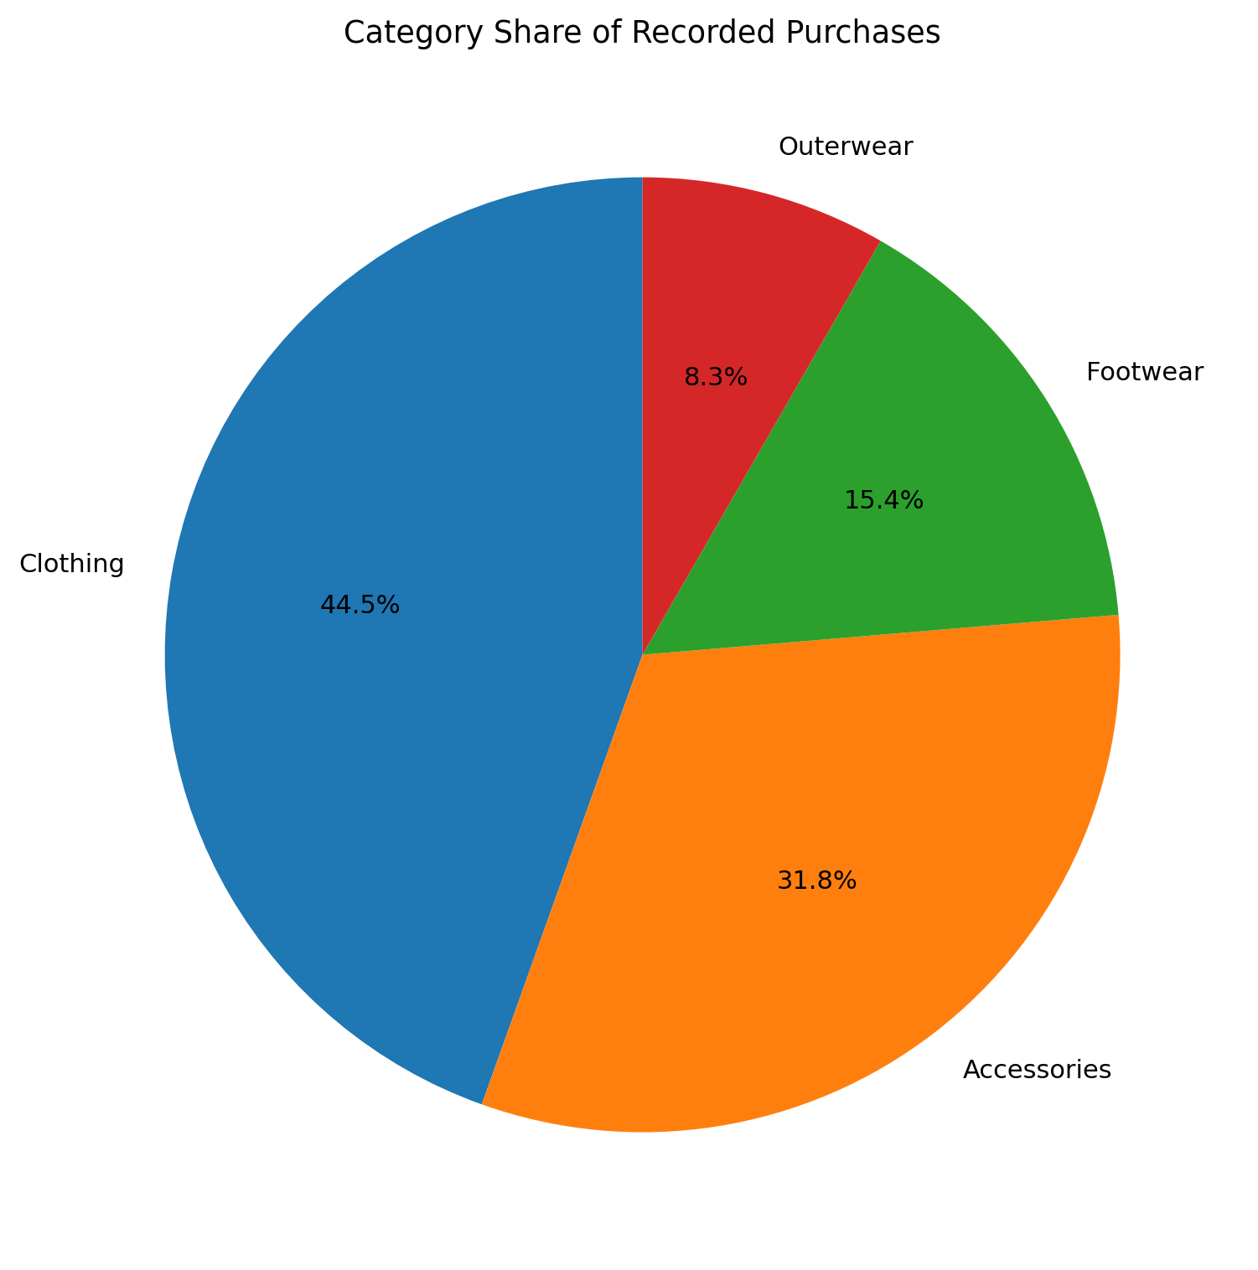
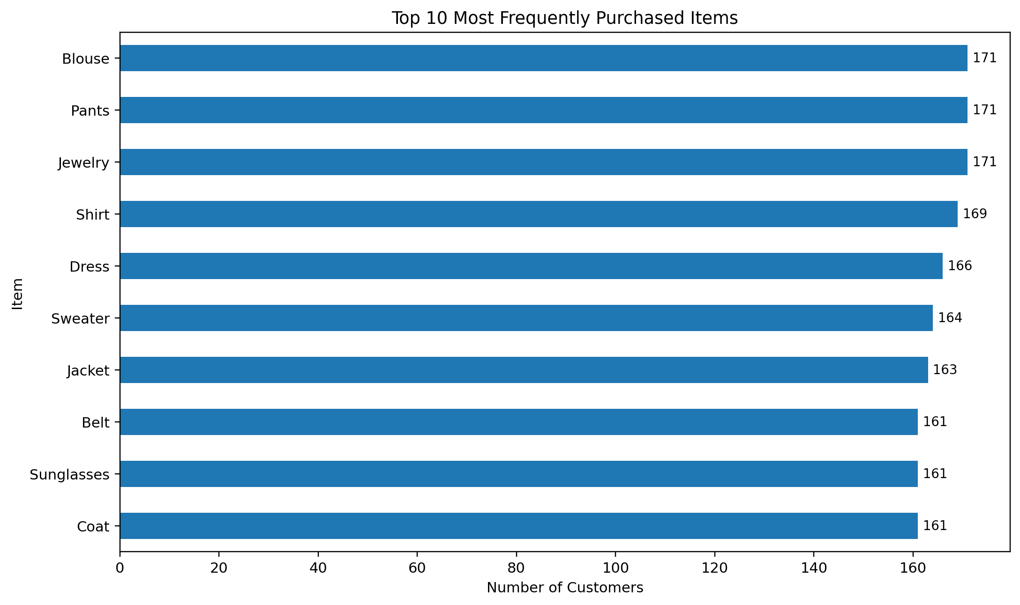
Product Mix and Purchase Behavior
The main category includes clothing(44.5%)
Then, Accessories follow(31.8%)
Popular products:
Pants
Jewelry
Blouse
Notes:
[Sources] - Dataset description: https://data.mendeley.com/datasets/xv99b2mtfk/1 - Public repo summary of the same 3,900-record shopping trends structure: https://github.com/nileshely/Customer-Shopping-Trends - Charts in this deck were generated locally from shopping_trends.csv using src/analyze_customer_behavior.py - Slide claims are derived directly from the locally generated top-items and category-share charts.

Slide 5
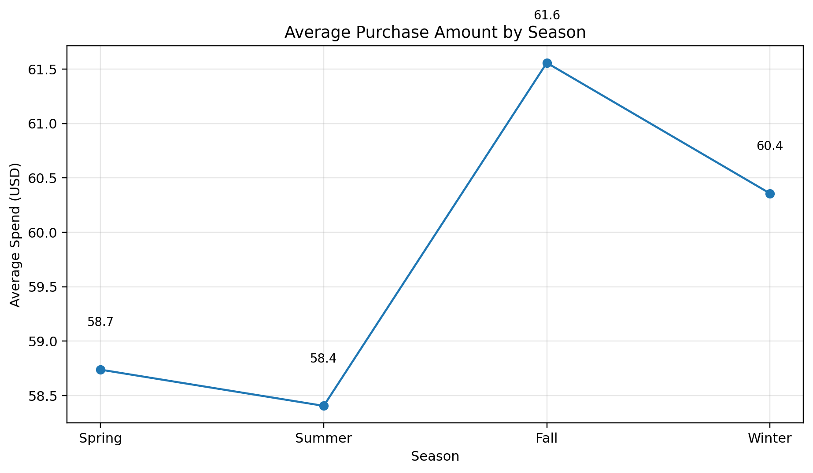
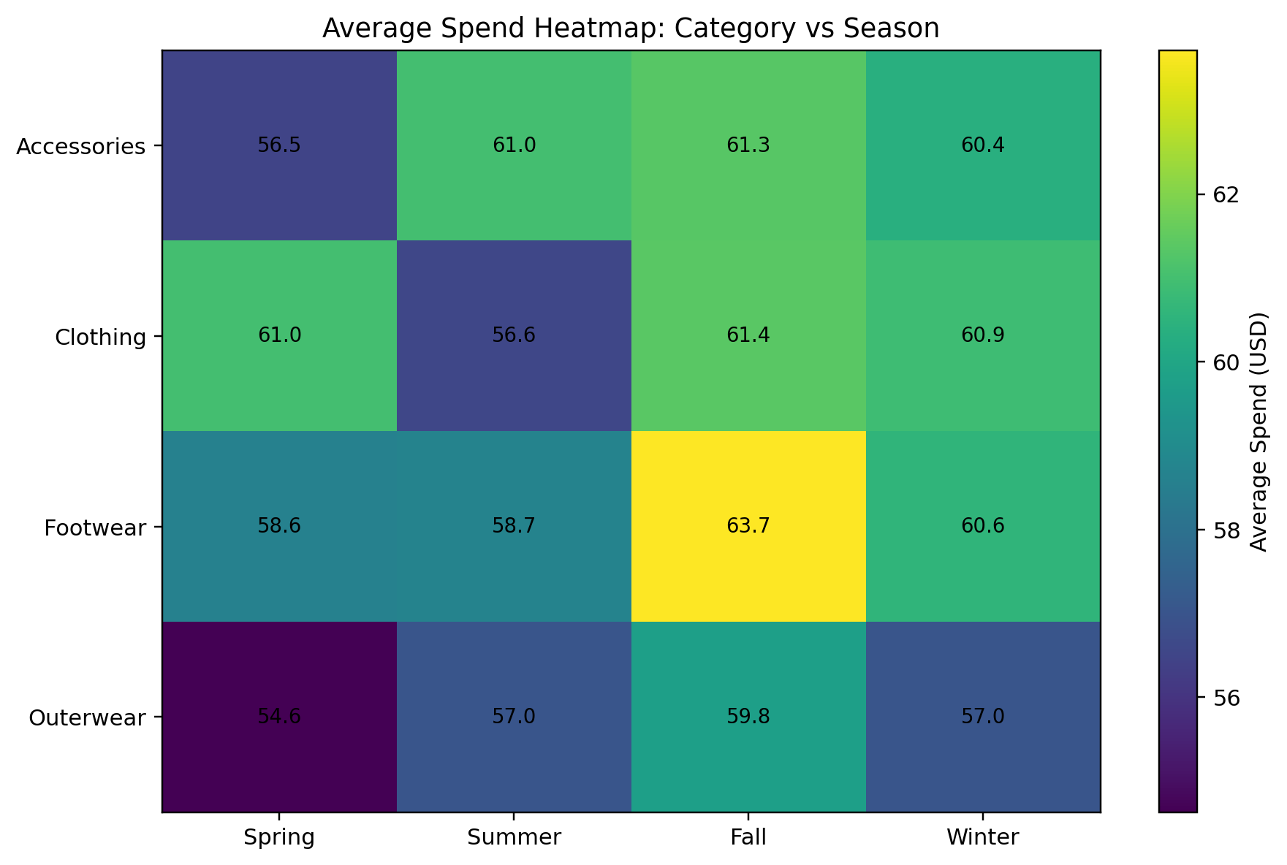
Seasonal trends
Observations
• Fall season registers the highest spending.
• Spring and Summer seasons are very close.
• Increase in sales of Footwears in Fall season.
• Disengaged Customers.
Key learning from seasonality: Autumn is ideal for category-oriented marketing drive.
Notes:
[Sources] - Dataset description: https://data.mendeley.com/datasets/xv99b2mtfk/1 - Public repo summary of the same 3,900-record shopping trends structure: https://github.com/nileshely/Customer-Shopping-Trends - Charts in this deck were generated locally from shopping_trends.csv using src/analyze_customer_behavior.py - Slide claims are derived from the seasonal spend line chart and category-season heatmap generated locally from the dataset.

Slide 6
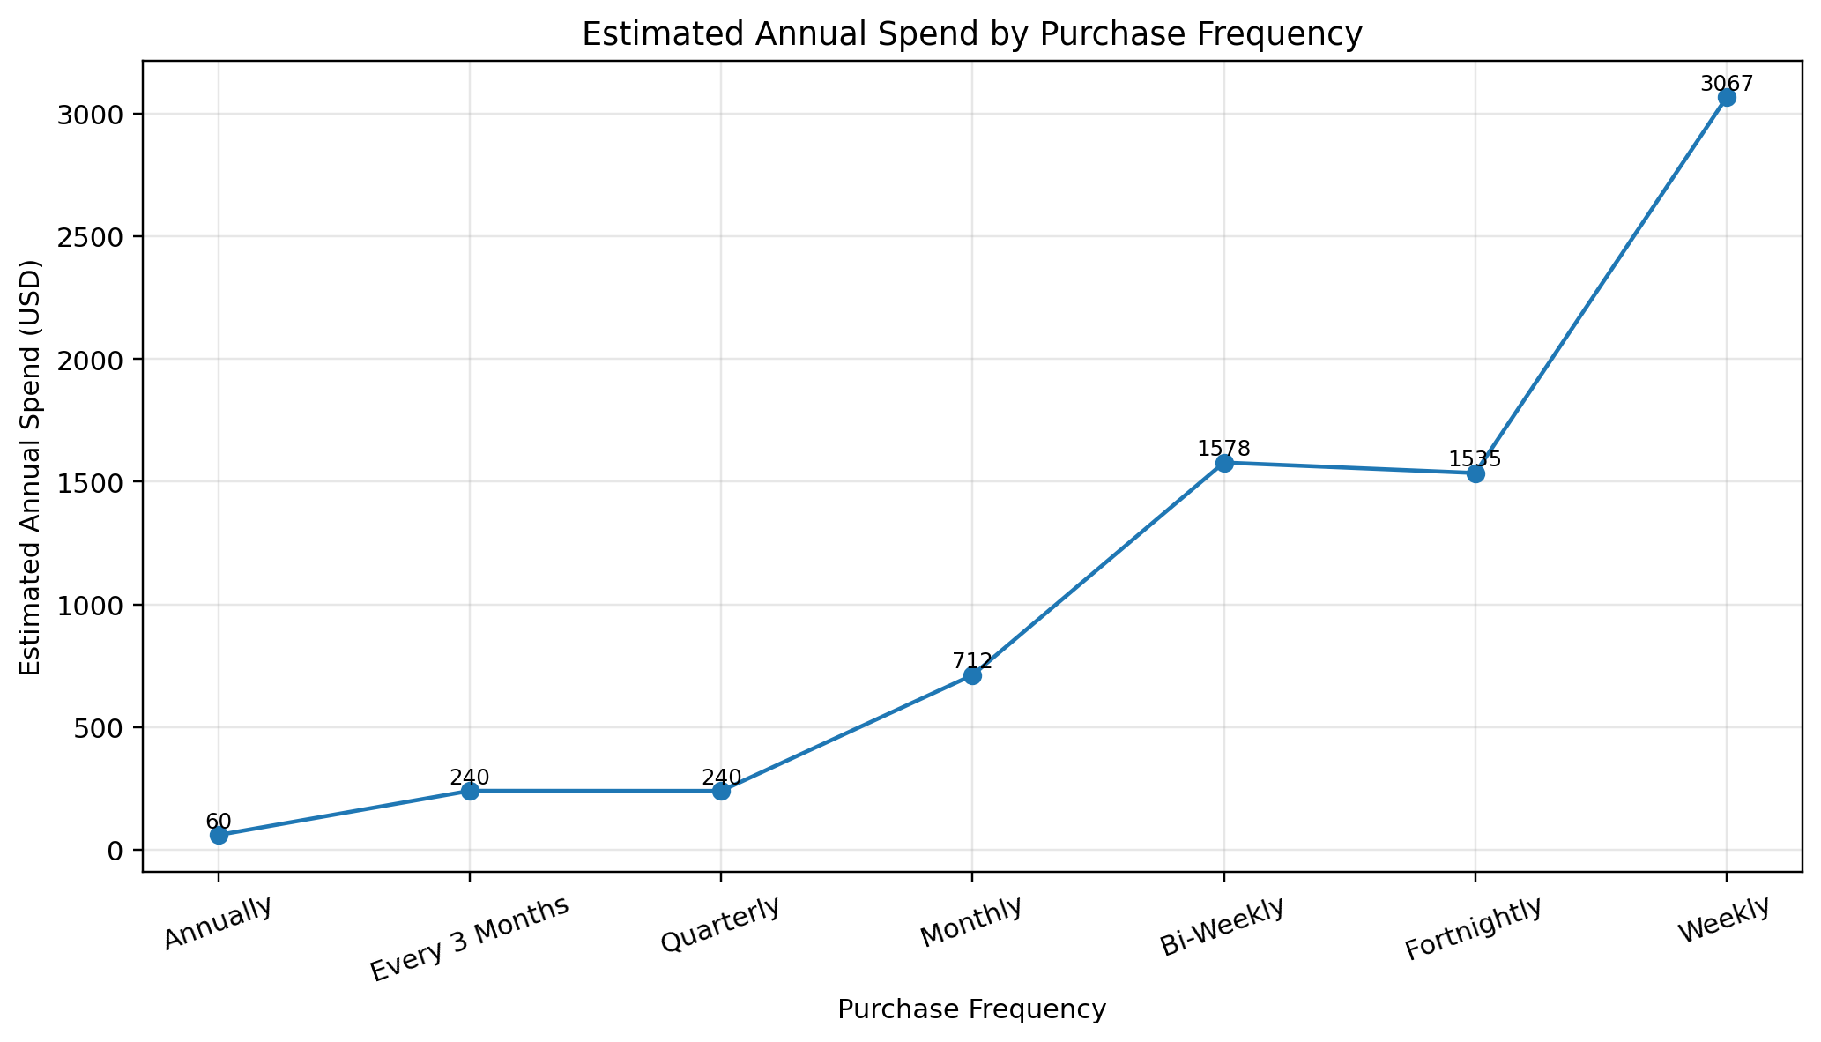
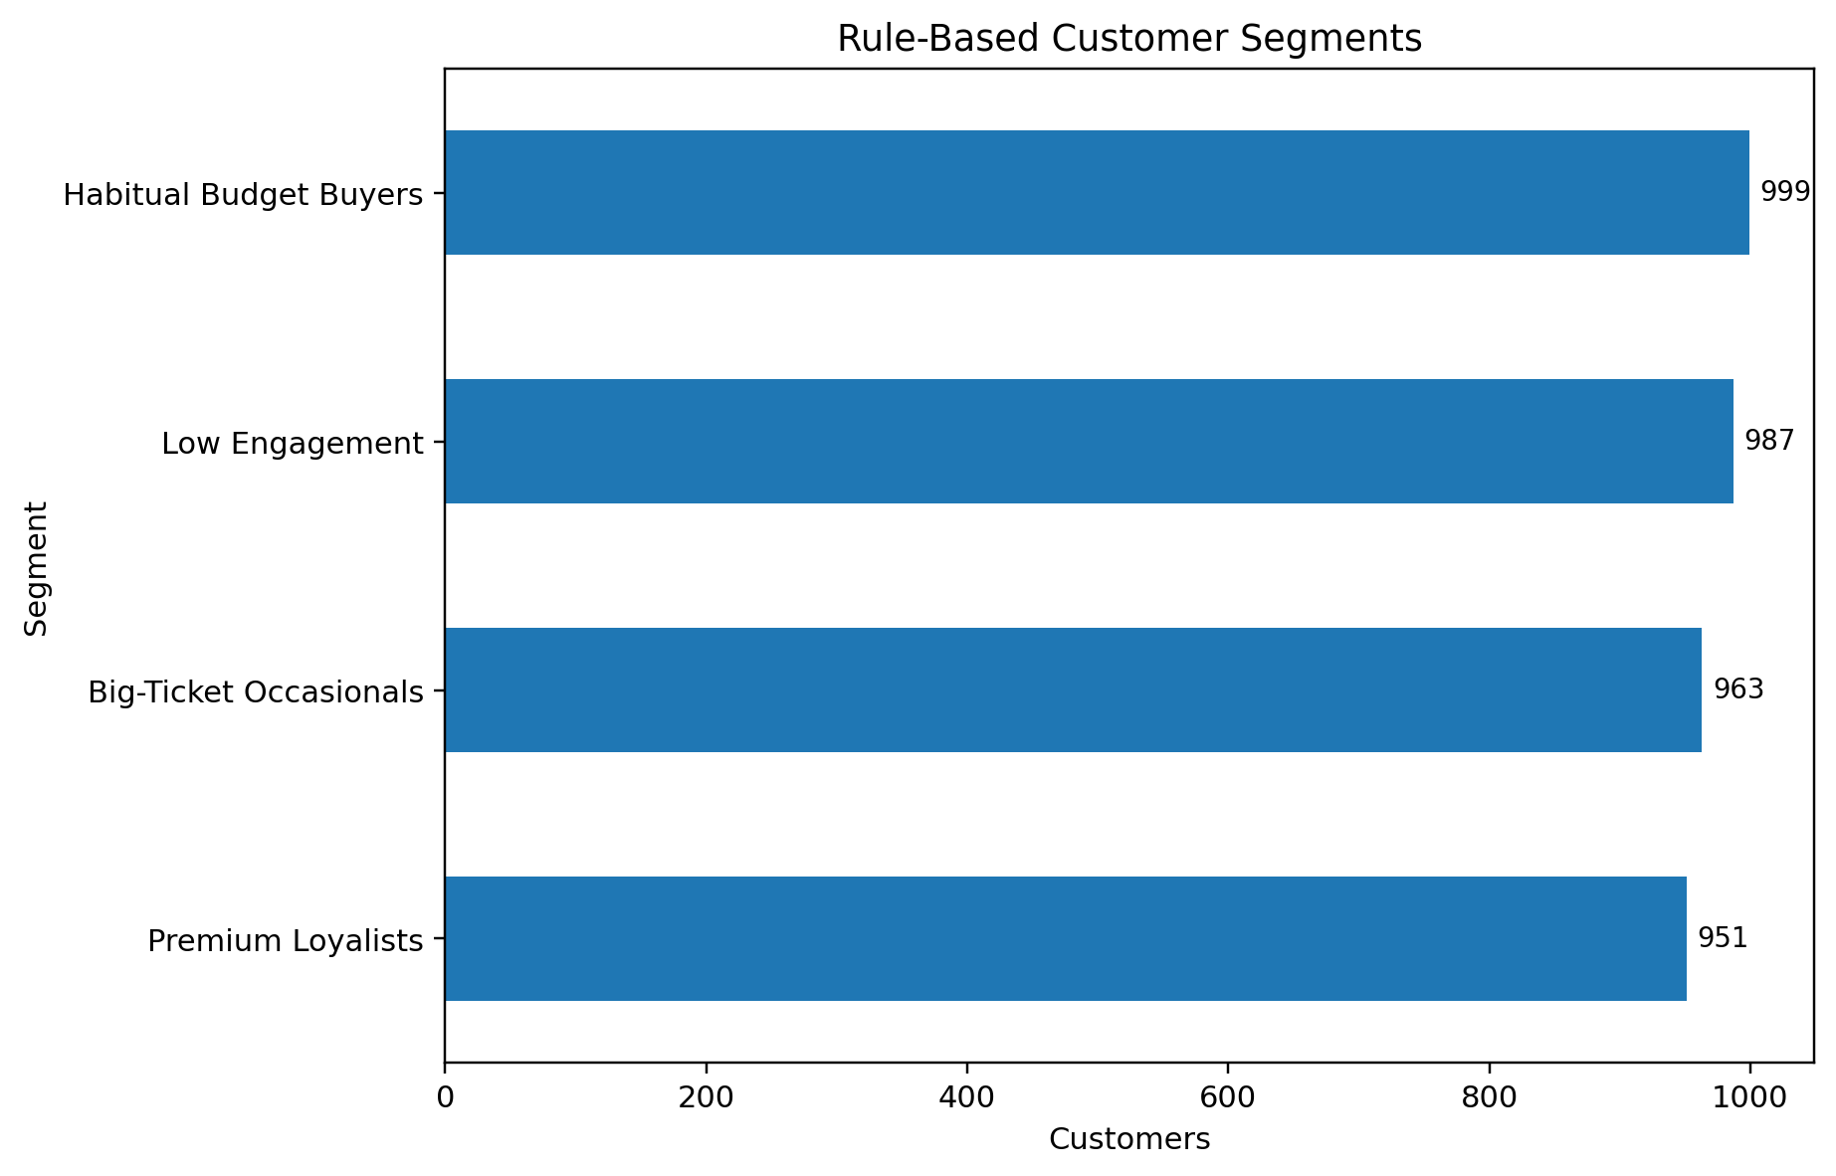
Frequency, Value, and Segmentation
Customer Segments
High value and frequent customers
High spenders but non-frequent customers
Frequent but low-spending customers
Non-responsive customers
Main lesson
Frequent spending customers may generate significant income even though the amounts spent each time are quite low. Therefore, it is more useful to look at annual spending rather than individual spending amounts.
Notes:
[Sources] - Dataset description: https://data.mendeley.com/datasets/xv99b2mtfk/1 - Public repo summary of the same 3,900-record shopping trends structure: https://github.com/nileshely/Customer-Shopping-Trends - Charts in this deck were generated locally from shopping_trends.csv using src/analyze_customer_behavior.py - Segment names and counts come from the rule-based logic implemented in src/analyze_customer_behavior.py.

Slide 7
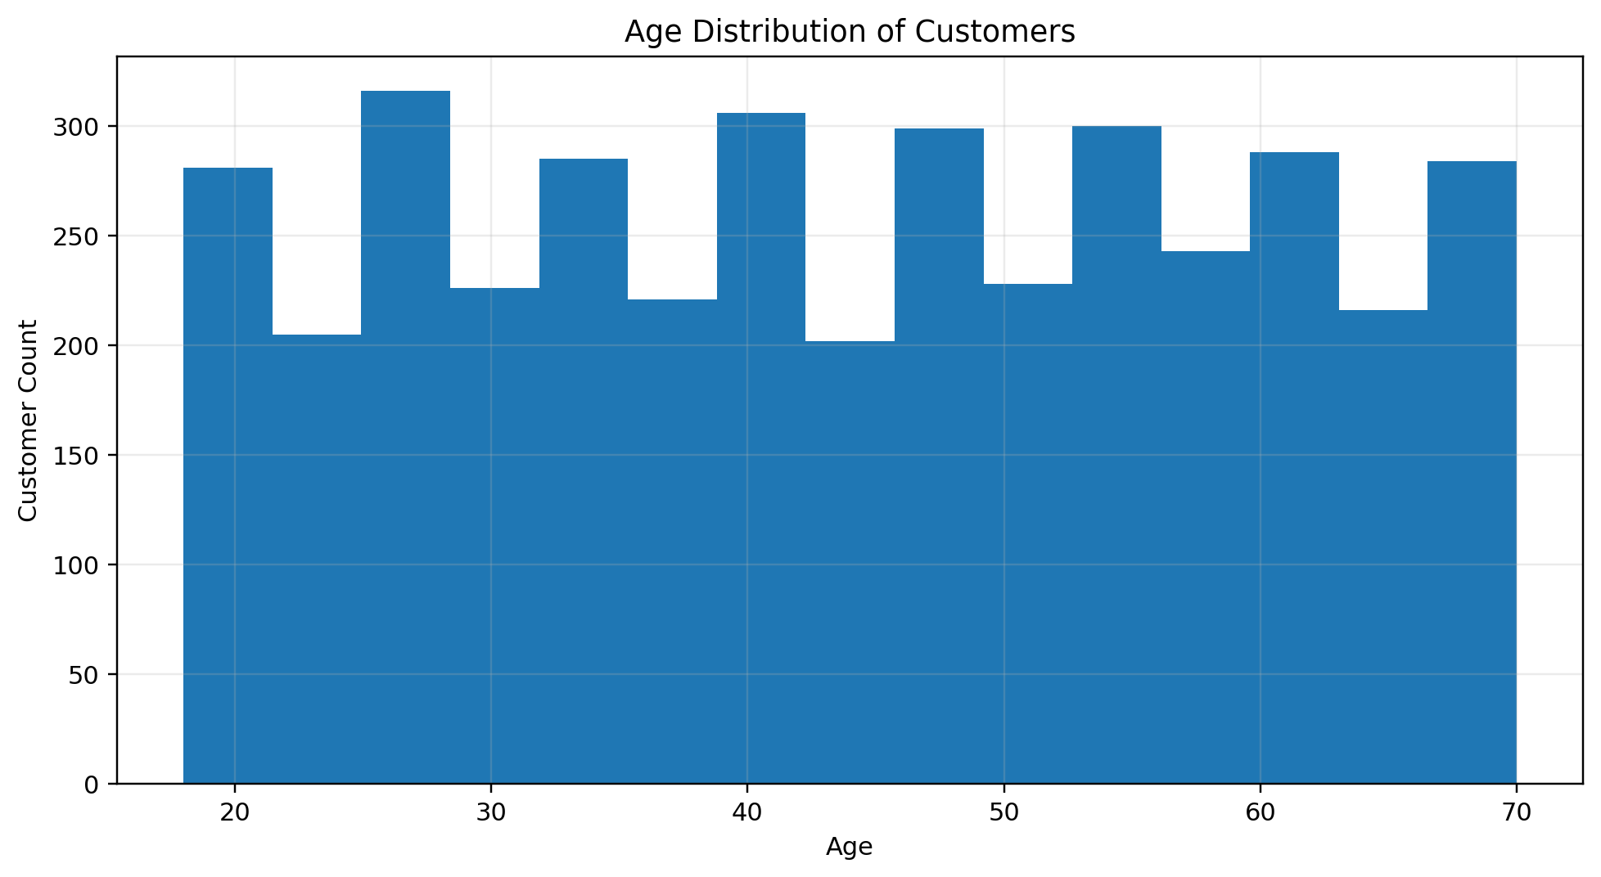
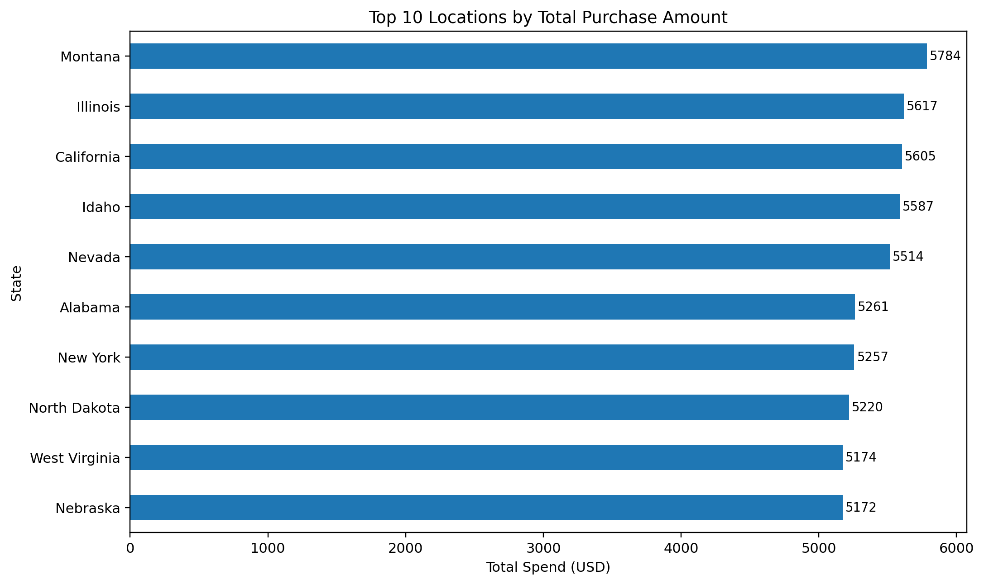
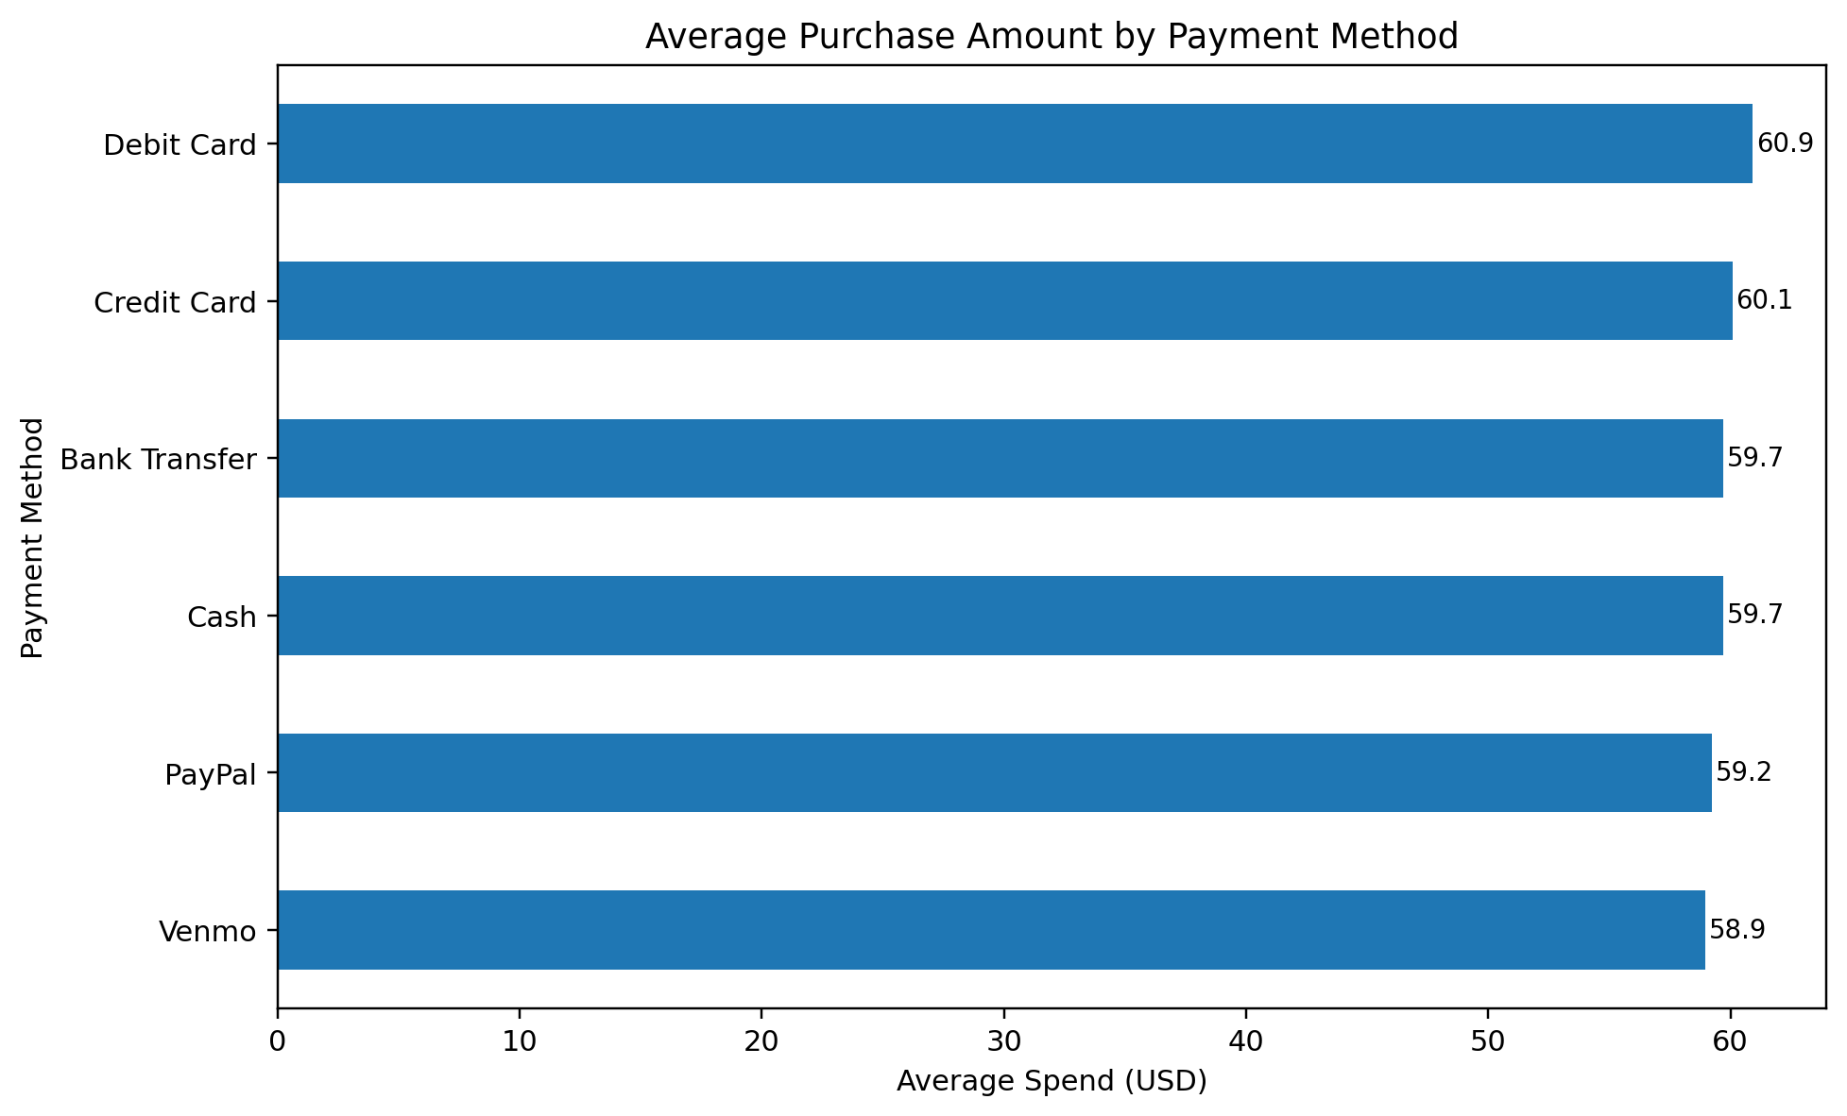
Demographics, Geography, and Payment Behavior
Reading
- The clients represent various age ranges.
- Credit and debit cards are used more by high spenders.
- Some states (such as California, Illinois) have higher total spending.
- The differences exist, but they are not very significant. As a result, the factors mentioned above must be taken into account along with other factors.
Notes:
[Sources] - Dataset description: https://data.mendeley.com/datasets/xv99b2mtfk/1 - Public repo summary of the same 3,900-record shopping trends structure: https://github.com/nileshely/Customer-Shopping-Trends - Charts in this deck were generated locally from shopping_trends.csv using src/analyze_customer_behavior.py - Slide claims are derived from the locally generated age distribution, payment-method, and top-locations charts.

Slide 8
Business Implications
Based on the analysis, a business could:
1. Focus more on apparel as the main category.
2. Bundle accessories with clothing items.
3. Plan marketing campaigns around the fall season.
4. Give importance to repeat customers, even if they spend less per purchase .
Notes:
[Sources] - Dataset description: https://data.mendeley.com/datasets/xv99b2mtfk/1 - Public repo summary of the same 3,900-record shopping trends structure: https://github.com/nileshely/Customer-Shopping-Trends - Charts in this deck were generated locally from shopping_trends.csv using src/analyze_customer_behavior.py - Business recommendations are interpretations of the locally generated visuals rather than externally quoted prescriptions.

Slide 9
Conclusion and Submission Assets
Conclusion
As part of this project, I analyzed consumer behavior using actual data and found patterns related to product categories, seasonal effects, and consumer segments.
Important note
Since the data is at the consumer level and not at the transaction level, some parameters such as purchase frequency and CLV are approximations. This was considered while drawing conclusions..
Notes:
[Sources] - Dataset description: https://data.mendeley.com/datasets/xv99b2mtfk/1 - Public repo summary of the same 3,900-record shopping trends structure: https://github.com/nileshely/Customer-Shopping-Trends - Charts in this deck were generated locally from shopping_trends.csv using src/analyze_customer_behavior.py

